Slide 1
Psychological First Aid

Slide 2
Psychological first aid (PFA) supportive response to a fellow human being who is suffering and who may need support.

Slide 3
Crisis intervention
Debilitating effects (e.g., emotional trauma, post-traumatic stress or physical harm)
Growth (e.g., new coping skills, new perspectives on life, or more options in living)

Slide 4
What PFA is not:
It is not something that only professionals can do.
It is not professional counselling.
It is not “psychological debriefing” in that PFA does not necessarily involve a detailed discussion of the event that caused the distress.
It is not asking someone to analyze what happened to them or to put time and events in order.
It is not about pressuring people to tell you their feelings and reactions to an event

Slide 5
Factors that seem to be most helpful to people`s long-term recovery:
Feeling safe, connected to others, calm and hopeful.
Having access to social, physical and emotional support.
Feeling able to help themselves, as individuals and communities.

Slide 6
Who is PFA for?
PFA is for distressed people who have been recently exposed to a serious crisis event.

Slide 7
How do crisis events affect people?

Slide 8
How someone reacts depends on many factors, including:
The nature and severity of the event(s) they experience
Their experience with previous distressing events
The support they have in their life from others
Their physical health
Their personal and family history of mental health problems
Their cultural background and traditions
Their age

Slide 9
When is PFA provided?
When you first have contact with very distressed people. This is usually during or immediately after an event.

Slide 10
Where is PFA provided?
Wherever it is safe enough for you to do so.
This is often in community settings, such as at the scene of an accident, or places where distressed people are served, such as health centers, shelters or camps.
where you can have some privacy to talk with the person when appropriate

Slide 11
How to help responsibly

Slide 12
Ethical Do’s and Don’ts as guidance to avoid causing further harm

Slide 13
Prepare – learn about the situation
Crisis event.
Available services and supports.
Safety and security concerns

Slide 14
Good Communication
Try to find a quiet place to talk, and minimize outside distractions
Respect privacy and keep the person`s story confidential, if this is appropriate.
Stay near the person but keep an appropriate distance depending on
their age, gender and culture.
Let them know you are listening; for example, nod your head or say
“hmmmm”
Be patient and calm

Slide 15
Good Communication
Provide factual information
Simple
Acknowledge how they are feeling
Acknowledge the person`s strengths
Allow for silence.

Slide 16
Good Communication
Don`t pressure someone to tell their story.
Don`t interrupt or rush someone`s story (for example, don`t look at your watch or speak too rapidly).
Don`t touch the person if you`re not sure it is appropriate to do so.
Don`t judge what they have or haven`t done, or how they are feeling.
Don`t say: “You shouldn`t feel that way”, or “You should feel lucky you survived”.
Don`t make up things you don`t know.

Slide 17
Good Communication
Don`t use terms that are too technical.
Don`t tell them someone else`s story.
Don`t talk about your own troubles.
Don`t give false promises or false reassurances.
Don`t think and act as if you must solve all the person`s problems for them.
Don`t take away the person`s strength and sense of being able to care for themselves.
Don`t talk about people in negative terms

Slide 18
Action principles of PFA
Look, Listen and Link

Slide 19
LOOK
Check for safety.
Check for people with obvious urgent basic needs.
Check for people with serious distress reactions.
Notes:
Are there people who appear extremely upset, not able to move on their own, not responding to others, or in shock? appearing withdrawn or very still
(not moving)
not responding to others, not speaking at all
disorientation (for example, not knowing their own name, where they are from, or what happened)
not being able to care for themselves or their children (for example, not eating or drinking, not able to make simple decisions)

Slide 20
LOOK
People may react in various ways to a crisis:
Physical symptoms
Crying, sadness, depressed mood
Being “on guard or jumpy”
Worry that something really bad is going to happen
Insomnia, nightmares
Irritability, anger
Guilt, shame
Confused, emotionally numb, or feeling unreal or in a daze

Slide 21
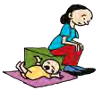
LOOK
Withdrawn or very still (not moving)
Not responding to others, not speaking at all
Disorientation
Not being able to care for themselves or their children (for example, not eating or drinking, not able to make simple decisions)

Slide 22
LOOK
Make sure that severely distressed people are not left alone
Try to keep them safe until the reaction passes or until you can find help

Slide 23
LISTEN
Approach people who may need support.
Ask about people’s needs and concerns.
Listen to people, and help them to feel calm.
Notes:
Approach: Approach people respectfully and according to their culture.
Introduce yourself by name and organization.
Ask if you can provide help.
If possible, find a safe and quiet place to talk.
Help the person feel comfortable; for example, offer water if you can.
Try to keep the person safe.
Try to protect the person from exposure to the media for their privacy and dignity.
If the person is very distressed, try to make sure they are not alone.
As k about people’s needs

Slide 24
LISTEN
Learn to listen with your:
Eyes: giving the person your undivided attention
Ears: truly hearing their concerns
Heart: with caring and showing respect

Slide 25
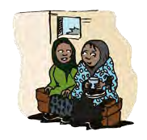
LISTEN
Stay close to the person.
Do not pressure the person to talk.
Listen in case they want to talk about what happened.
If they are very distressed, help them to feel calm and try to make sure they are not alone.

Slide 26
Help people to feel calm
Keep your tone of voice calm and soft.
If culturally appropriate, try to maintain some eye contact with the person as you talk with them.
Remind the person that you are there to help them. Remind them that they are safe, if it is true.

Slide 27
LINK
Linking people with practical support is a major part of PFA.
PFA is often a one-time intervention and you may only be there to help for a short time. Affected people will need to use their own coping skills to recover in the long term.
Help people to help themselves and to regain control of their situation.

Slide 28
LINK
Help people address basic needs and access services.
Help people cope with problems.
Give information.
Connect people with loved ones and social support.
Notes:
Understandable and correct information about the event, loved ones and
available services.
Being able to contact loved ones, friends and other social supports.
Access to specific support related to one’s culture or religion.
Being consulted and involved in important decisions.

Slide 29
Help people cope with problems:
Help people identify supports in their life
Ask the person to consider how they coped with difficult situations in the past, and affirm their ability to cope with the current situation
Ask the person what helps them to feel better. Encourage them to use positive coping strategies and avoid negative coping strategies

Slide 30
Encourage positive coping strategies
Get enough rest.
Eat as regularly as possible and drink water.
Talk and spend time with family and friends.
Discuss problems with someone you trust.
Do activities that help you relax (walk, sing, pray, play with children).
Do physical exercise.
Find safe ways to help others in the crisis and get involved in community activities.

Slide 31
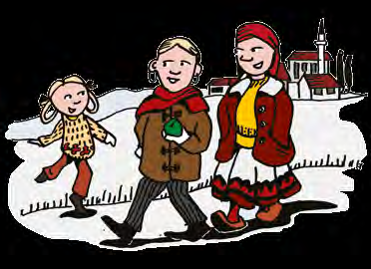
Discourage negative coping strategies
Don’t take drugs, smoke or drink alcohol.
Don’t sleep all day.
Don’t work all the time without any rest or relaxation.
Don’t isolate yourself from friends and loved ones.
Don’t neglect basic personal hygiene.

Slide 32
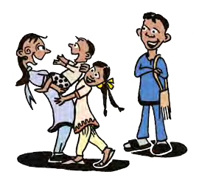
Connect with loved ones and Social Support
Help keep families together
Help people to contact friends
If a person lets you know that prayer, religious practice or support from religious leaders might be helpful for them, try to connect them with their spiritual community
Help bring affected people together to help each other

Slide 33
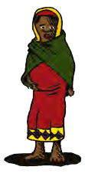
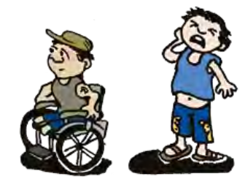
people who likely need Special attention
Remember that all people have resources to cope, including those who are vulnerable. Help vulnerable people to use their own coping resources and strategies.

Slide 34
Younger children
Give them extra time and attention.
Remind them often that they are safe.
Explain to them that they are not to blame for bad things that happened.
Avoid separating young children from caregivers
Keep to regular routines and schedules as much as possible.
Give simple answers about what happened without scary details.
Allow them to stay close to you if they are fearful or clingy.
Be patient with children who start demonstrating behaviours they did when they were younger, such as sucking their thumb or wetting the bed.

Slide 35
Older children and adolescents
Give them your time and attention.
Help them to keep regular routines.
Provide facts about what happened and explain what is going on now.
Allow them to be sad. Don’t expect them to be tough.
Listen to their thoughts and fears without being judgmental.
Ask them about the dangers they face, support them and discuss how they can best avoid being harmed.
Encourage and allow opportunities for them to be helpful.

Slide 36
Ending your help
Notes:
If someone else will be helping them from that point on, try and introduce them to that person. If you have linked the person with other services, let them know what to expect
and be sure they have the details to follow up. No matter what your experience has been with the person, you can say goodbye in a positive way by wishing them well.

Slide 37
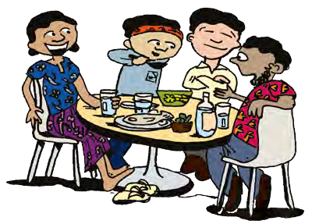
Taking Care of Yourself: Remember!
First responders and others in the helping professions may also be vulnerable to similar adverse reactions!
Getting ready to help.
Managing stress: Healthy work and life habits.
Rest and reflection.

Slide 38
Example
Natural Disaster
LOOK LISTEN LINK

Slide 39
Example
Natural Disaster
Ready?
Safe place
Introduce yourself
Offer some help
Listen and stay near Reflect
Need?
Help people to connect

Slide 40
Example
Accident
LOOK LISTEN LINK

